Slide 1
IOOS QARTOD & OOI QC Procedures
Leila Belabbassi, Oceanographer
GCOOS Data Manager
Department of Oceanography,
Texas A&M University, College Station

Slide 2
Add word Paradigm
QC Procedure
Develop and create automated test for measurements,
Examine test results to identify and address the errors and, omissions
Establish a data flag system or a data annotation service to communicate results,
And finally, document all QC activities to ensure data correctness, completeness, and reuse.

Slide 3
Add word Paradigm
QC Procedure
Develop and create automated test for measurements
Examine test results to identify and address the errors and omissions
Establish a data flag system or a data annotation service to communicate results
And finally document all QC activities to ensure data correctness, completeness, and reuse

Slide 4
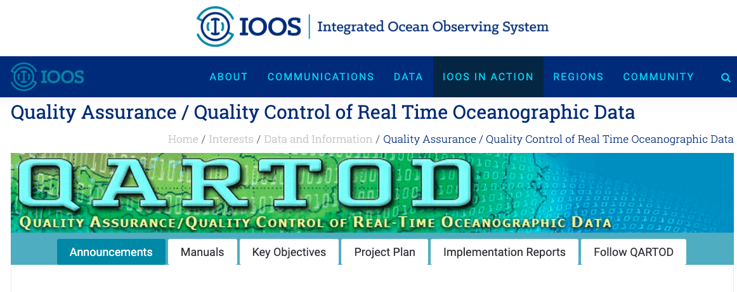


Slide 5
Resources
IOOS:
https://ioos.noaa.gov/project/qartod/
IOOS-GitHub:
https://github.com/ioos/ioos_qc https://github.com/ioos/ioos_qc/tree/master/docs/source/examples
OOI:
https://oceanobservatories.org/quality-control/
OOI-GitHub:
https://github.com/ooici/ion-functions/tree/master/ion_functions/qc
https://github.com/petercable/shared_notebooks

Slide 6
QC Tests / Flags
OOI
QARTOD
OOI QC Test:
dataqc_globalrangetest
dataqc_localrangetest
dataqc_spiketest
dataqc_polytrendtest
dataqc_stuckvaluetest
dataqc_gradienttest
IOOS QARTOD Tests:
Gap_test
Syntax_test
Location_test
gross_range_test
climatology_test
spike_test
rate_of_change_test
flat_line_test
Multi-Variate Test
Attenuated Signal Test
Neighbor Test
TS Curve/Space Test
Density Inversion Test
OOI QC Flags:
[1: Pass]
[0: Fail]
IOOS QARTOD Flags:
[1: Pass]
[2: Unknown]
[3: Suspect]
[4: Fail]
[9: Missing]
** Summary Flag

Slide 7
OOI 1.0 – Data Evaluation
https://github.com/ooi-data-lab/data-review-tools
QARTODS |  |  | OOI 1.0 Datasets Review
Group 1 Required | Test 1 Test 2 Test 3 Test 4 Test 5 | Gap Test Syntax Test Location Test Gross Range Test Climatological Test | √ Data Coverage √ (is a number / precision not checked) √ Lat Lon Diff √ Valid Data Human in The Loop
Group 2 Strongly Recommended | Test 6 Test 7 Test 8 | Spike Test Rate of Change Test Flat Line Test | √ STD - -
Group 3 Suggested | Test 9 Test 10 Test 11 Test 12 Test 13 | Multi-Variate Test Attenuated Signal Test Neighbor Test TS Curve/Space Test Density Inversion Test | Human in The Loop Human in The Loop - - -
Group OOI | Test Test Test Test Test Test Test |  | Preferred Stream Pressure Comparison Sampling Rate Time Order End/start test Missing Data Data Comparison Missing Coordinates in File
Rutgers University Data Review Portal:
https://datareview.marine.rutgers.edu/

Slide 8



QC Test / Flags - Example

Slide 9
Thank you

